Slide 1
“Souls on Board”
Since Homeland Security has reserved the use of the word “Sovereign” for use by the de facto corporation making the de facto corporation a replica of the European style of Sovereignty where “We the people” are subjects of the government,
And made it almost a crime to declare oneself as a sovereign in the District of Columbia.
We recommend the use of the phrase Sovereign Soul on the Dry Land when explaining our political status.

Slide 2
A Definition
Did you know that the de facto corporation has a name for the real human? This name was discovered when looking at the manifest handed from the Aircraft crew to ground personnel when an aircraft was “out of the blocks” at the gate.
The real people are called “Souls on Board”.

Slide 3
pursuing a goal that is Neither lawless nor Violent
Means that there is an established governing law.
It is this law that is the subject matter of this course.
It has been in effect since before 1000 AD.
It is known as “The Fundamental Law” and is referred to by many as “the unwritten constitution”

Slide 4
“The Fundamental Law” - “the unwritten constitution”
Its most active form is called the Law of the Land and Due process of Law and is set out in Chapter 39 of the Magna Carta.

Slide 5
Two Forms of Ecclesiastical Sovereignty
American Style Ecclesiastical Sovereignty
We the People are the Principals
The Government Offices are the Agents
The people are Sovereign Souls on the Land and administer the Law of the Land
European Style Ecclesiastical Sovereignty
The Government Offices are the Principals
The people are wards and subjects of the government.
The Government is the Sovereign and administers all laws.

Slide 6
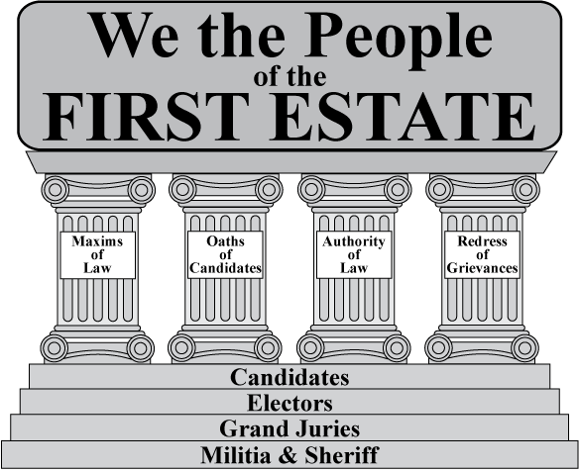
First Estate Logo

Slide 7
The First Estate; i.e., We the People… A Self Government Introduction
A Body Politic United:
by Having entered into a pledged compact with each other,
by Pledging to be Electors, Jurists, Candidates and members of the militia,
pursuing a goal that is Neither lawless nor Violent, and
Dedicated to constituting / ratifying three republican form of governments

Slide 8
Forms Used
Declaration of Sovereign Rights held by Indigenous Power
Declaration of Intent to Assemble and Adhere to the Standards of a Jurist
The First Estate of _____________ County, Texas Congregation _________ of the Texian Jural Society Congregation _________ of The National Jural Society

Slide 9
Jural Societies are Fully Nested (Sample)
First Estate County, State & National Jural Society Congregation Numbers
County First Estate First Estate Texas Jural National Jural
Jural (FEJ) Region (FER) Society (TJS) Society (NJS)
Anderson 2 1 1-2 Tex1-2
Andrews 3 7 7-3 Tex7-3
Angelina 4 2 2-4 Tex2-4
Aransas 5 4 4-5 Tex4-5

Slide 10
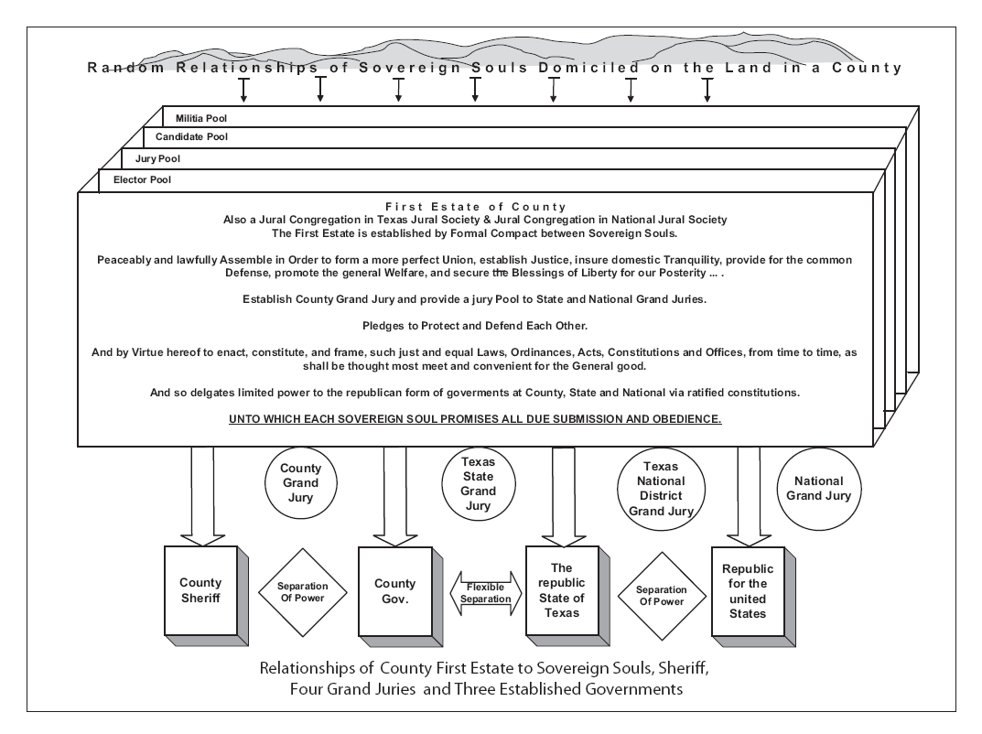
The First Estate Diagram

